Slide 1
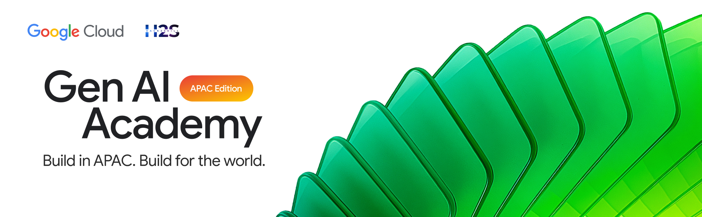
PARTICIPANT DETAILS a. Participant name : Hariharan C b. Problem Statement : Build AI-powered applications using AI-ready databases like AlloyDB. c. Github repo link : https://github.com/BlackWizard123/Track-3---Book-store-NL2SQL-GCP d. Cloud Run URL : https://bookstore-api-1059652519537.us-central1.run.app/

Slide 2
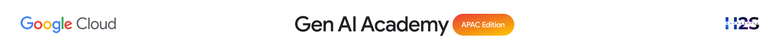
Brief about the idea
Bookstore AI - Bookstore database hosted on AlloyDB (PostgreSQL)
Users query the database using plain English — no SQL needed
Gemini AI converts the question into a valid SQL query
SQL executes live on AlloyDB and returns real results
Gemini generates a human-friendly answer from the results
Delivered via a clean chat interface deployed on Cloud Run

Slide 3
Meeting the Build Criteria How did you navigate the requirements of your chosen track to build a custom solution - using ADK, MCP, or AlloyDB AI that effectively addresses the 'What You Must Build' criteria?
Custom bookstore dataset created from scratch (authors, books, orders)
Table schemas designed and populated manually in AlloyDB
Gemini AI integrated to enable natural language querying
Every user question is converted to SQL and executed live
Results passed back to Gemini to generate meaningful responses
Fully deployed end-to-end on Google Cloud — not just a local demo

Slide 4
Opportunities
How different is it from any of the other existing ideas?
Most NL-to-SQL tools are generic or demo-only. This is a fully deployed, end-to-end working application on Google Cloud with a real database, real queries, and real answers — not a prototype. How will it be able to solve the problem?
Removes the SQL barrier entirely. Any non-technical user — a store manager, analyst, or student — can get data insights instantly just by asking a question in plain English.
USP of the proposed solution
The combination of AlloyDB + Gemini gives both enterprise-grade database reliability and state-of-the-art AI understanding in a single lightweight API — deployable in minutes on Cloud Run.

Slide 5
List of features offered by the solution
Natural language to SQL conversion
Live query execution on AlloyDB
AI-generated human-friendly answers
Generated SQL visible for transparency
Results displayed as a formatted table
Health check with live DB status
Suggestion chips for quick queries
Deployable via Google Cloud Run

Slide 6
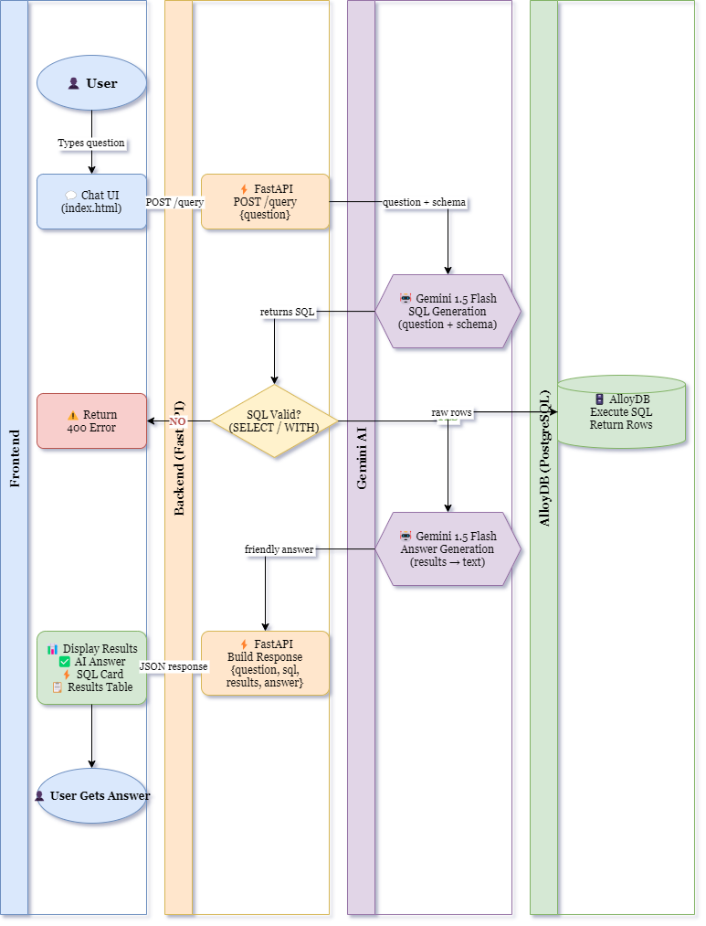
Process flow diagram or Use-case diagram

Slide 7
Technologies used in the solution
AlloyDB — PostgreSQL database on Google Cloud
Gemini 1.5 Flash — NL-to-SQL + answer generation
FastAPI — backend API and query orchestration
psycopg2 — AlloyDB connection and query execution
Cloud Run — serverless deployment
HTML/CSS/JS — chat interface

Slide 8
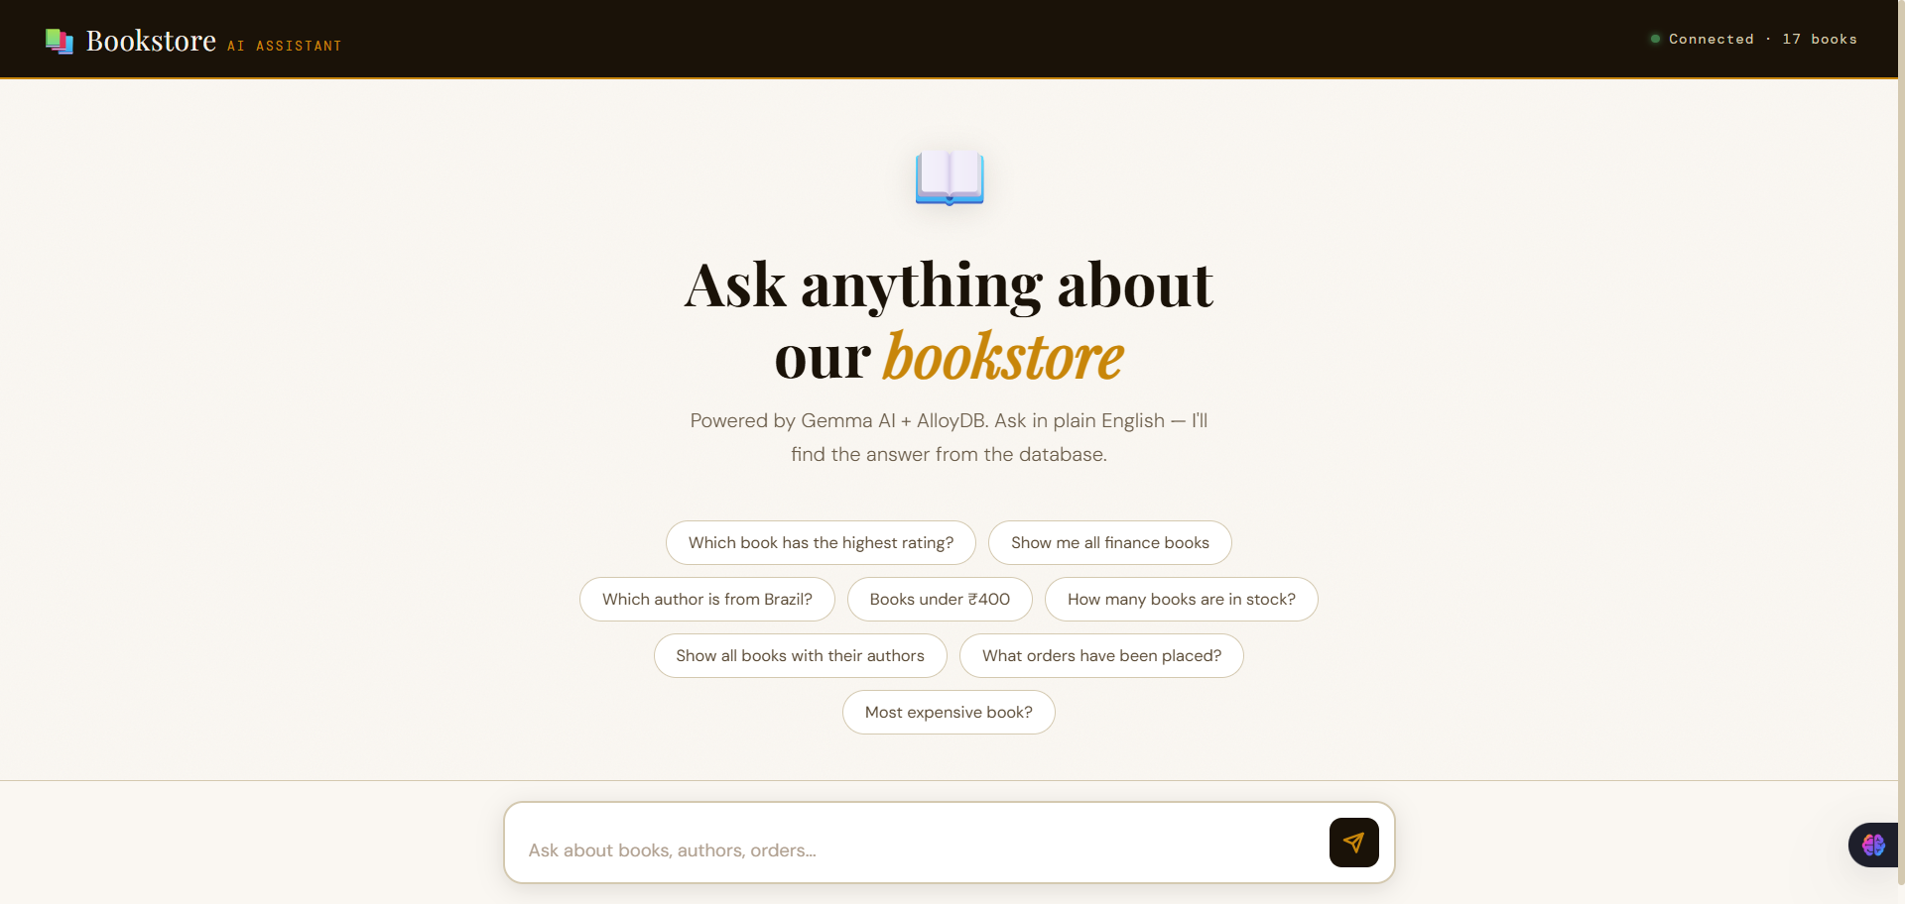
Snapshots of the prototype
https://bookstore-api-1059652519537.us-central1.run.app/

Slide 9
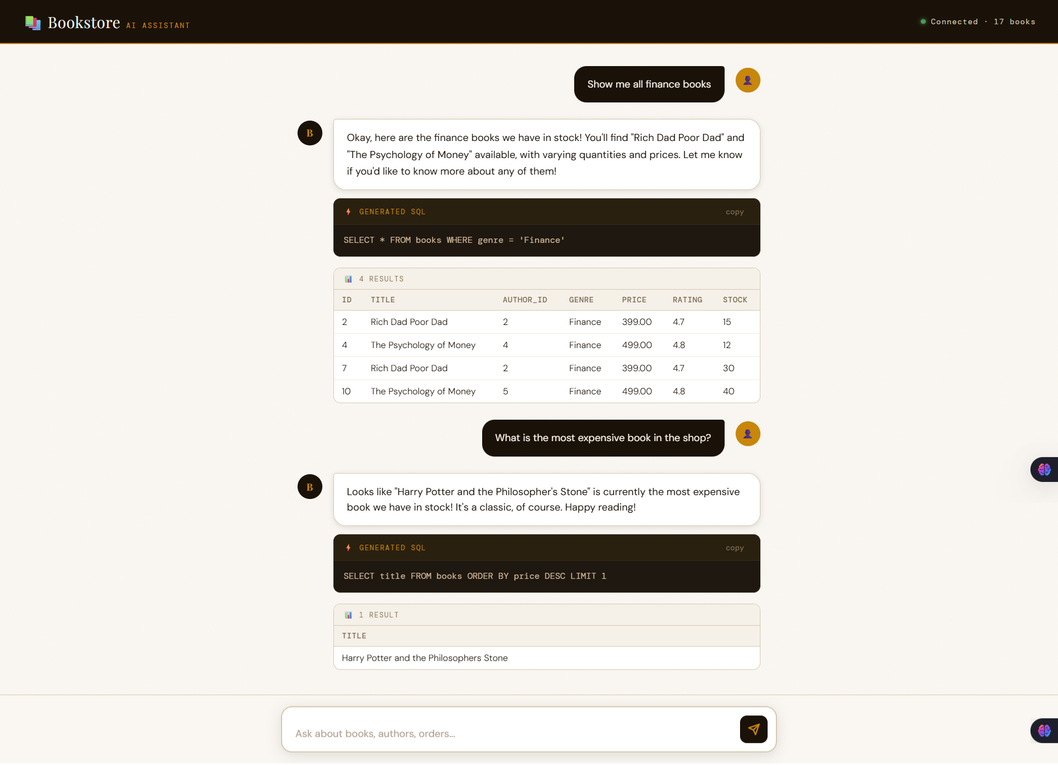
https://bookstore-api-1059652519537.us-central1.run.app/

Slide 10
